Slide 1
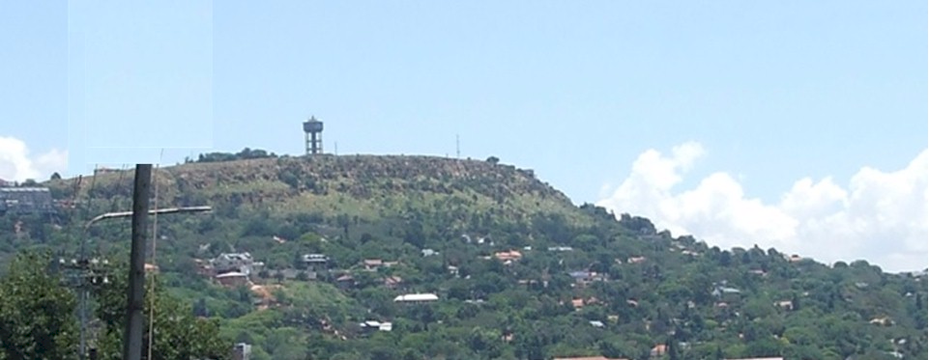

Turning history on its head
Massive evidence of a global flood
What does it all mean?
Part 6 – Incised Valley’s
End Time Issue Ministries
Dr James A Robertson PrEng
Notes:
A view of the valleys from Northcliff?
And the theme photo of Northcliff – just showing where the incision has taken place
Valley at Craighall or another valley?
Valley at Swartruggens with cliffs and vertical incision?

Slide 2
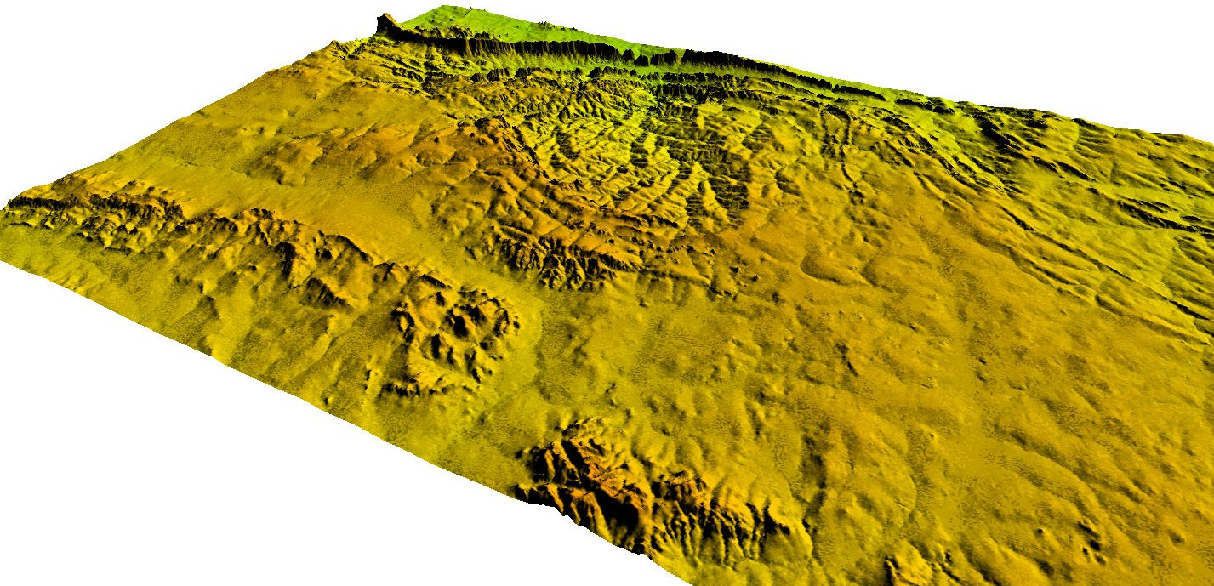

What the remaining surface of the dome actually evidences
Dome
Digital Terrain Model
Courtesy of Paul Wilson
Sales Manager of ComputaMaps
Tel: +27 21 700 8140 (8145 direct line)
Fax: +27 21 701 9520
Skype ID: computamaps-rsa
email: pwilson@computamaps.com
Website: http://www.computamaps.com
Private Bag X20, Constantia, 7848, South Africa
Notice how the ground has been removed between the high points
Notes:
View from Northcliff or somewhere else where the incision is particularly noticeable and clear
View from within a valley, on the road somewhere, maybe near Fritz?

Slide 3
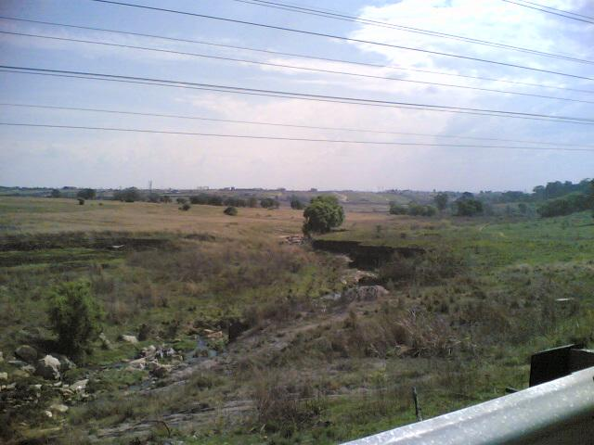
What the remaining surface of the dome actually evidences
Near Allandale
Small stream
Wide flat valley
Stream does not have erosive capacity to cut this valley
Rough rocks in stream bed
Notes:
View from Northcliff or somewhere else where the incision is particularly noticeable and clear
View from within a valley, on the road somewhere, maybe near Fritz?

Slide 4
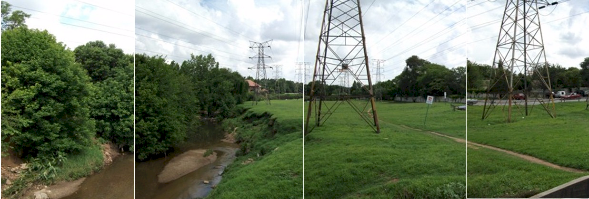
What the remaining surface of the dome actually evidences
Craighall
Small stream
Wide flat valley
Stream does not have erosive capacity to cut this valley
Rough rocks in stream bed
Notes:
View from Northcliff or somewhere else where the incision is particularly noticeable and clear
View from within a valley, on the road somewhere, maybe near Fritz?

Slide 5
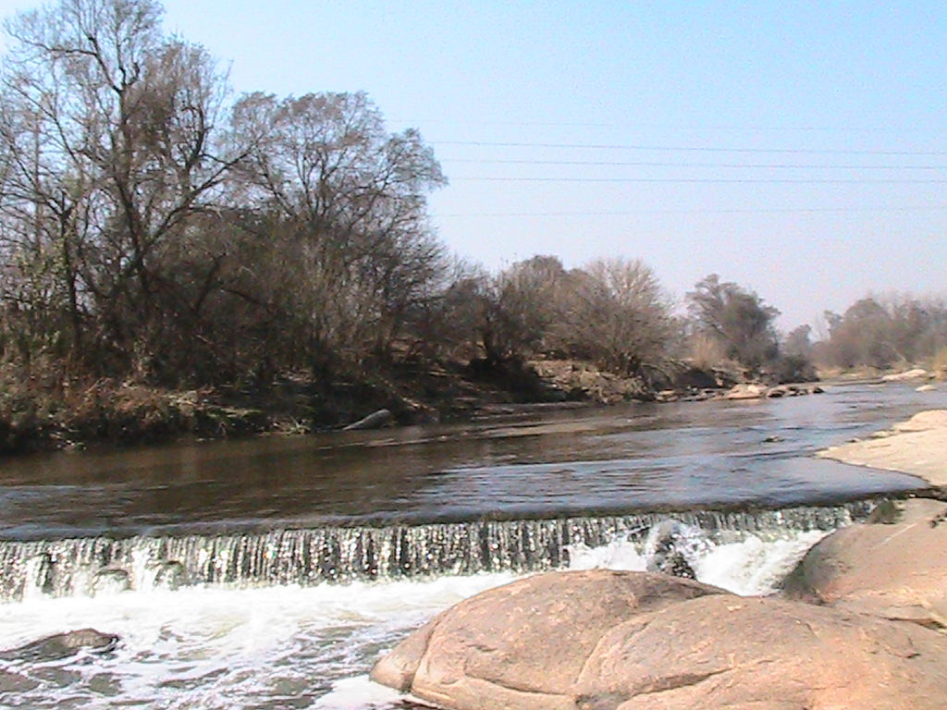
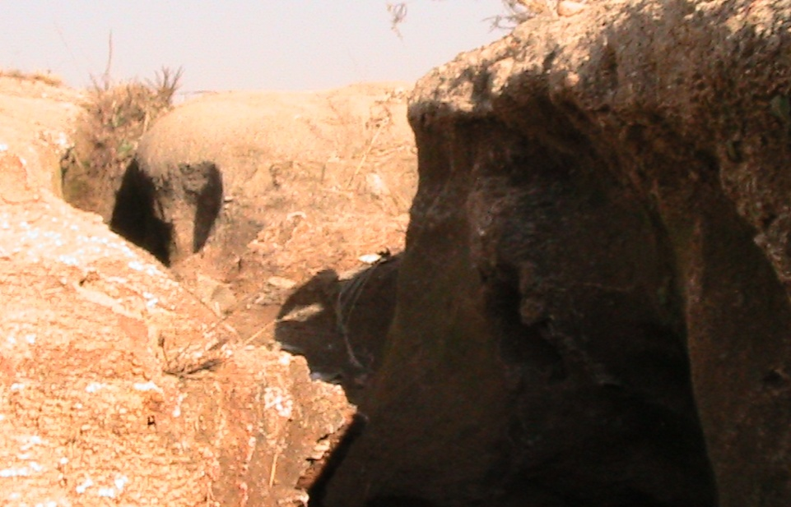
Little streams with flat valleys
The streams could never erode valleys like these, the erosive capacity is far too low, even in flood
Would produce narrow valleys
Not even able to erode
the granite rocks in the
bottom of the stream
Notes:
Craighall, Fritz

Slide 6

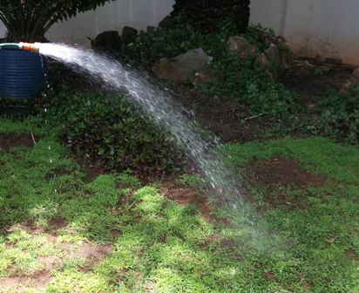
Gentle rain does NOTHING it is all about high velocity water
Low velocity water nurtures plants it does NOT erode however long it flows
Even if it flows for millions of years
Notes:
Garden sprinkler
Hose at different pressures
May need to shoot a new bit of video for hose scouring away material
Velocity versus bed load from paper from web

Slide 7
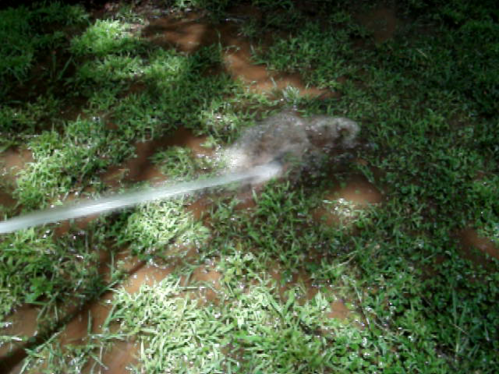
Gentle rain does NOTHING it is all about high velocity water
Notes:
Garden sprinkler
Hose at different pressures
May need to shoot a new bit of video for hose scouring away material
Velocity versus bed load from paper from web

Slide 8
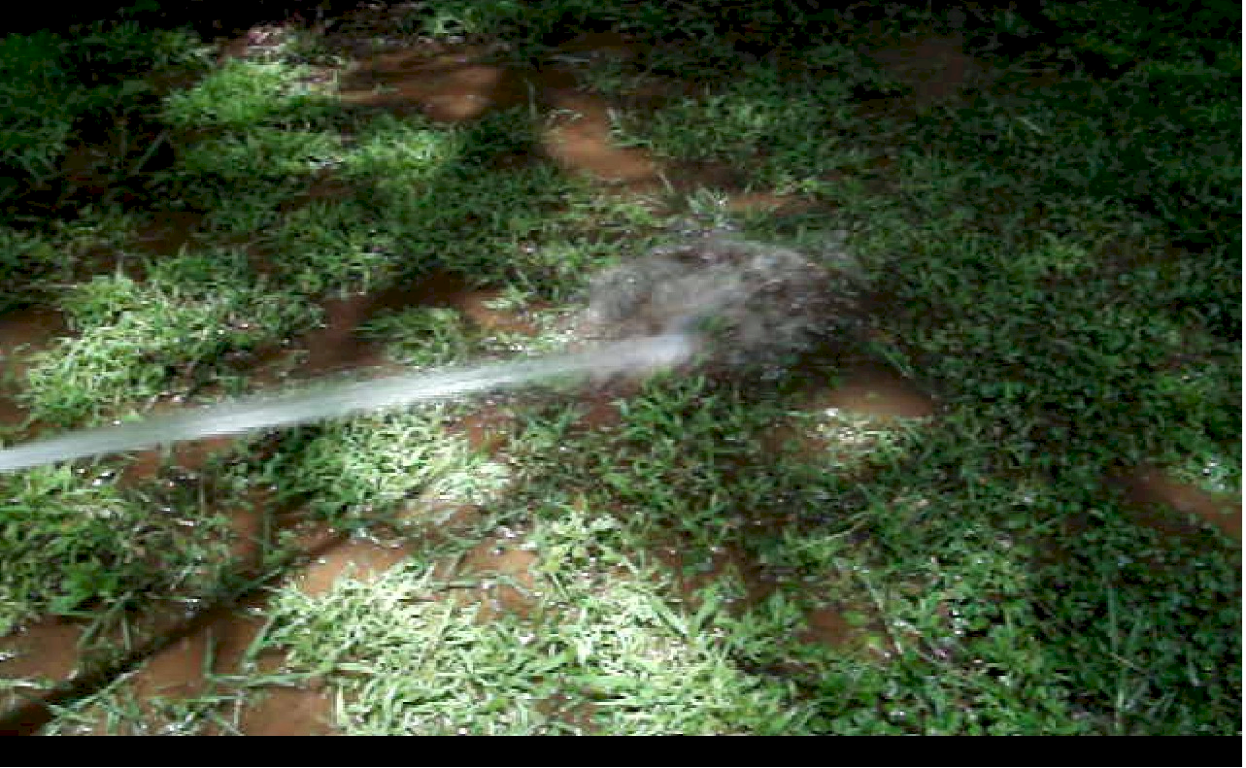
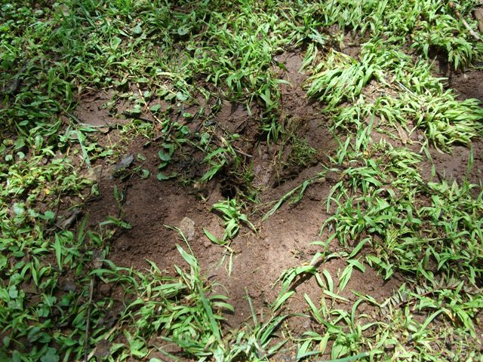
Gentle rain does NOTHING it is all about high velocity water
Notes:
Garden sprinkler
Hose at different pressures
May need to shoot a new bit of video for hose scouring away material
Velocity versus bed load from paper from web

Slide 9
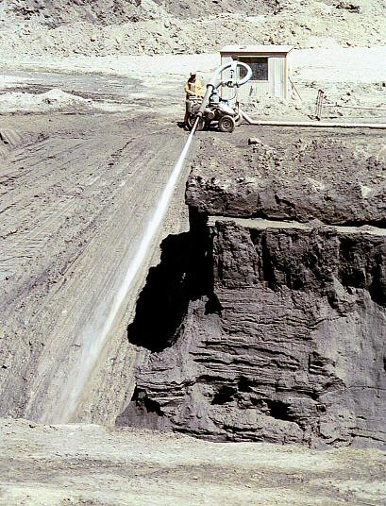
Gentle rain does NOTHING it is all about high velocity water
High velocity water erodes rapidly and continues eroding until there is nothing left to erode
Notes:
Garden sprinkler
Hose at different pressures
May need to shoot a new bit of video for hose scouring away material
Velocity versus bed load from paper from web

Slide 10
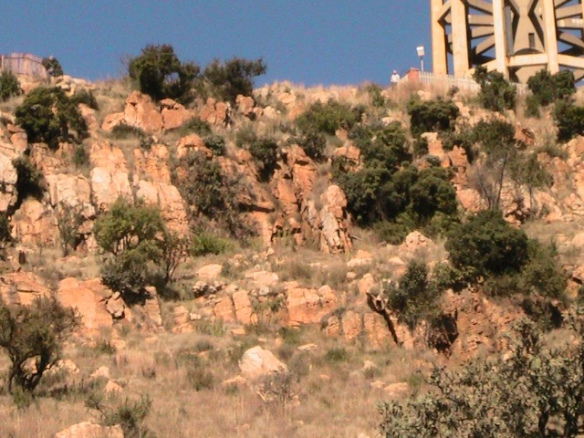
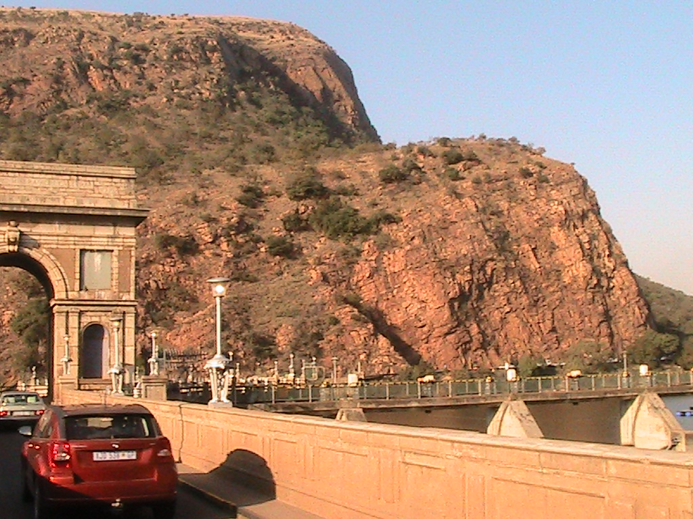
Plucked cliff faces
Northcliff
Hartebeespoort (Magaliesberg)
Rocks have been plucked out of sheer cliff faces
Notes:
Various cliff faces and hill tops – large boulders standing free, how did they get left behind, where has the material around them gone
Top of Table Mountain
Clean, sharp edges

Slide 11
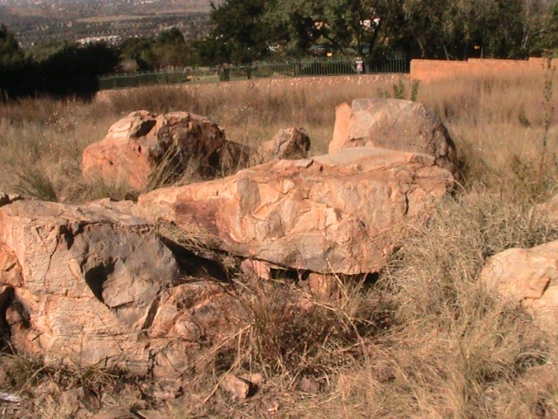
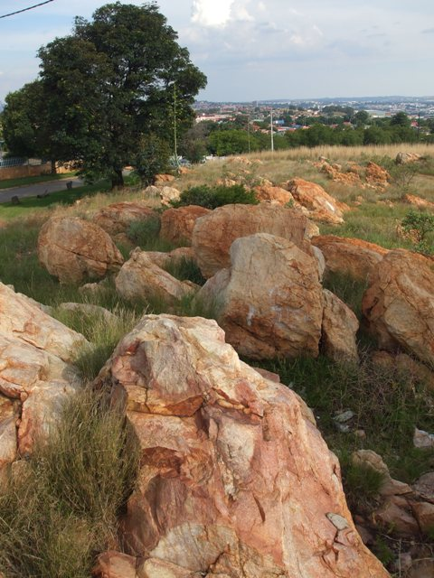
Plucked hill tops
Northcliff
Large rocks plucked out of the TOPS of hills
NOT gentle erosion by rain
Boiling water with massive tsunamis?
Gordon Road
Notes:
Various cliff faces and hill tops – large boulders standing free, how did they get left behind, where has the material around them gone
Top of Table Mountain
Clean, sharp edges

Slide 12
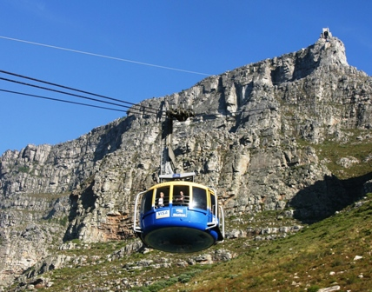
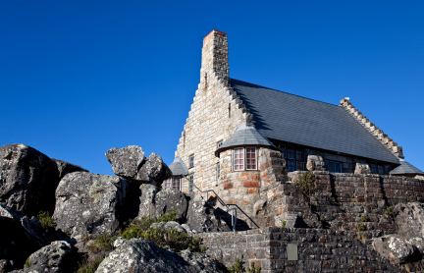
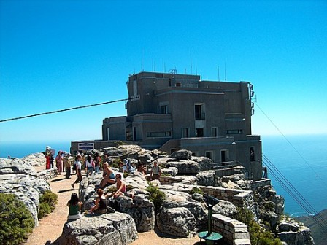
Plucked cliff faces and hill tops
All over the world
Table mountain
Cliff
Top
Notes:
Various cliff faces and hill tops – large boulders standing free, how did they get left behind, where has the material around them gone
Top of Table Mountain
Clean, sharp edges

Slide 13
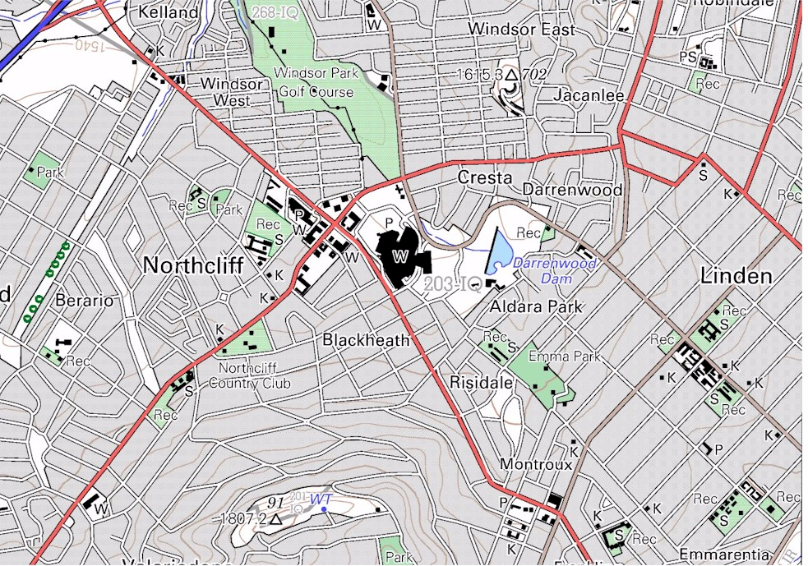
Where has all the rock gone?
300 m drop in 3,000 m at Northcliff
1500
1540
300 m vertical over 3,000 meters
Northcliff 1807
Notes:
Flash back to cut out from Northcliff, rough estimate of volume say 50km radius, 100 m deep gives approximately 2,000 km squared and nearly 200 cubic kilometers of material, that is 200,000,000,000 cubic meters of material that has disappeared down hill potentially first stop Eastern Limpopo and possibly the Mozambique Channel – find a suitable map – atlas?
Bigger problem with the Drakensberg whether eastern Mapumalanga and Limpopo or Kwa Zulu Natal and also with Table Mountain and, and, and

Slide 14
Where has all the rock gone?
Over the Halfway House Granite Dome about
600 cubic kilometers of rock and earth have been
removed (600 thousand million cubic meters)
The river flow is downhill all the way to the low ground of Limpopo province, about 1,000 kilometers
This material was all removed through the Hartebeespoort gorge
Massive high velocity water flows are the only possible mechanical explanation
Notes:
Flash back to cut out from Northcliff, rough estimate of volume say 50km radius, 100 m deep gives approximately 2,000 km squared and nearly 200 cubic kilometers of material, that is 200,000,000,000 cubic meters of material that has disappeared down hill potentially first stop Eastern Limpopo and possibly the Mozambique Channel – find a suitable map – atlas?
Bigger problem with the Drakensberg whether eastern Mapumalanga and Limpopo or Kwa Zulu Natal and also with Table Mountain and, and, and

Slide 15
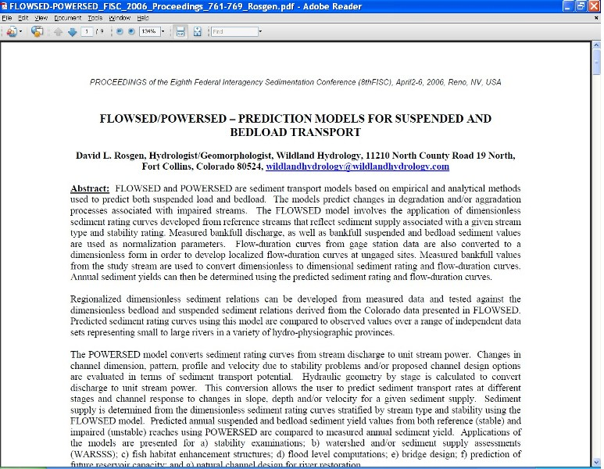
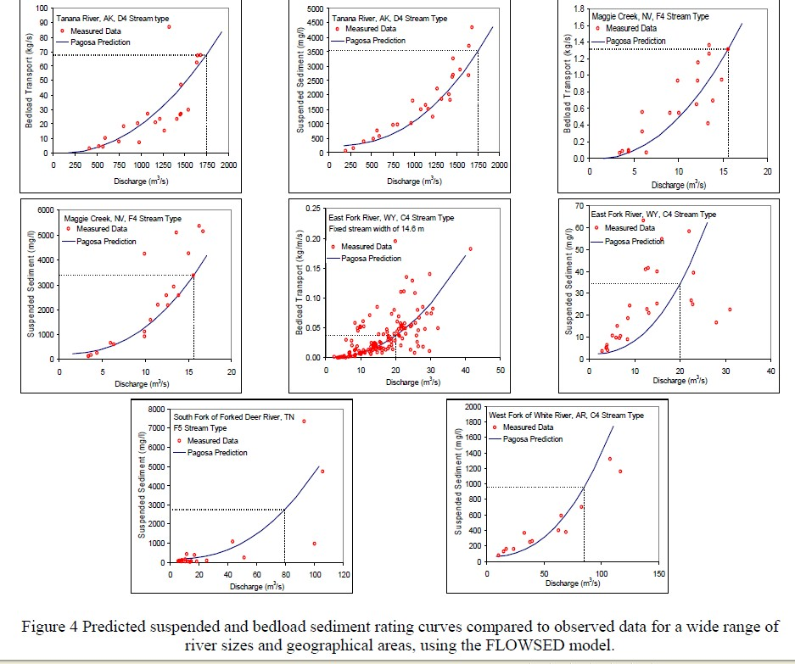
Where has all the rock gone?
Suspended river load
River bed load
Increase exponentially with velocity
What happens at extremely high flood velocities beyond anything we have ever experienced?
Notes:
Flash back to cut out from Northcliff, rough estimate of volume say 50km radius, 100 m deep gives approximately 2,000 km squared and nearly 200 cubic kilometers of material, that is 200,000,000,000 cubic meters of material that has disappeared down hill potentially first stop Eastern Limpopo and possibly the Mozambique Channel – find a suitable map – atlas?
Bigger problem with the Drakensberg whether eastern Mapumalanga and Limpopo or Kwa Zulu Natal and also with Table Mountain and, and, and

Slide 16

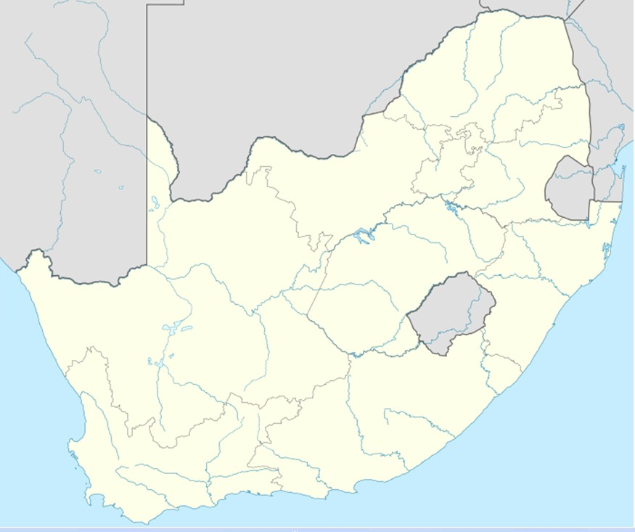
Where has all the rock gone?
River flow
All this distance
All through this one gorge
Notes:
Flash back to cut out from Northcliff, rough estimate of volume say 50km radius, 100 m deep gives approximately 2,000 km squared and nearly 200 cubic kilometers of material, that is 200,000,000,000 cubic meters of material that has disappeared down hill potentially first stop Eastern Limpopo and possibly the Mozambique Channel – find a suitable map – atlas?
Bigger problem with the Drakensberg whether eastern Mapumalanga and Limpopo or Kwa Zulu Natal and also with Table Mountain and, and, and

Slide 17
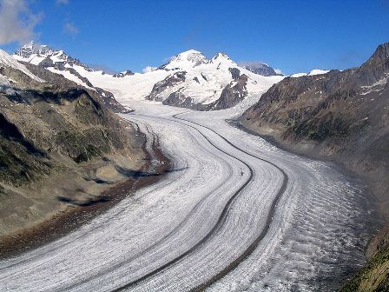
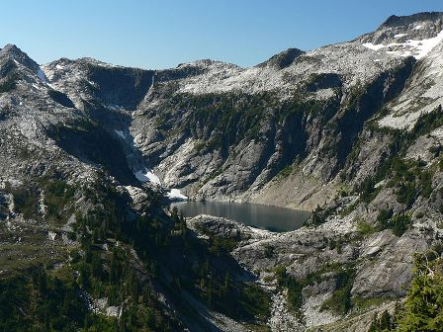
Glacier action?
No
Valleys are the wrong shape
Notes:
I have been asked whether eroded by ice – valley form is wrong – find photos on Internet
Evaporation – try evaporating on stove
Evaporation point for rock is extremely high – glass in dust from current volcano – refer to the Star
Ditto solution

Slide 18

Evaporation?
Notes:
I have been asked whether eroded by ice – valley form is wrong – find photos on Internet
Evaporation – try evaporating on stove
Evaporation point for rock is extremely high – glass in dust from current volcano – refer to the Star
Ditto solution

Slide 19
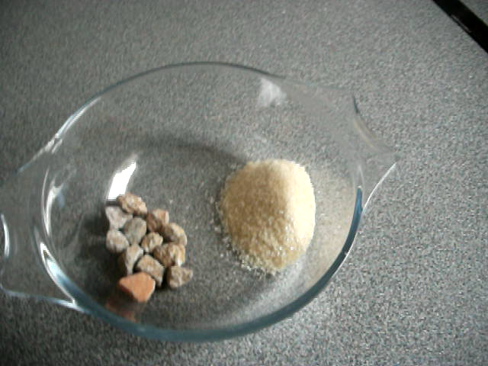
Dissolved?
Notes:
I have been asked whether eroded by ice – valley form is wrong – find photos on Internet
Evaporation – try evaporating on stove
Evaporation point for rock is extremely high – glass in dust from current volcano – refer to the Star
Ditto solution

Slide 20
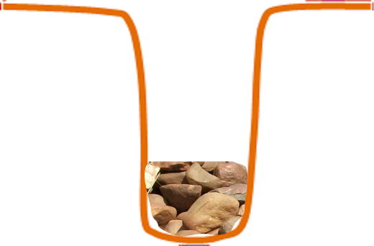
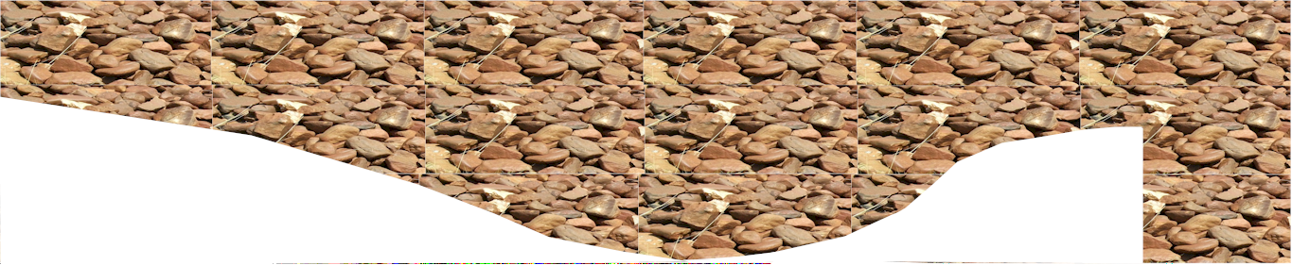
Erosion of valleys
Limited bedload = narrow valley
Large bedload = wide flat valley
Notes:
Flash back to cut out from Northcliff, rough estimate of volume say 50km radius, 100 m deep gives approximately 2,000 km squared and nearly 200 cubic kilometers of material, that is 200,000,000,000 cubic meters of material that has disappeared down hill potentially first stop Eastern Limpopo and possibly the Mozambique Channel – find a suitable map – atlas?
Bigger problem with the Drakensberg whether eastern Mapumalanga and Limpopo or Kwa Zulu Natal and also with Table Mountain and, and, and

Slide 21
A huge problem to explain
The rock was not removed by ice
It did not evaporate
It did not dissolve
It can only have been
eroded by massive
water suction resulting
from high velocity
Coupled with boiling water?
How could this happen?
Notes:
If the rock was indeed washed into the Mozambique Channel we have another problem -- where did the Mozambique Channel come from?
And the Mariana Trench?
Huge holes into which huge volumes of material have seeming disappeared?
And where did the water come from and where did it go?

Slide 22
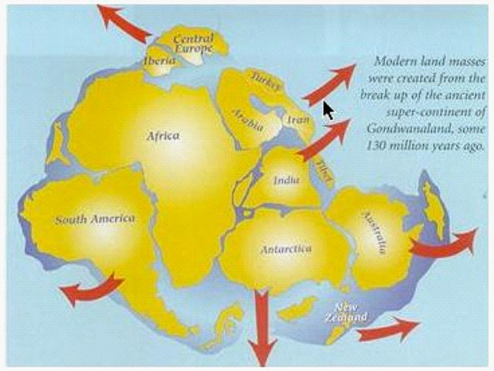
Continental separation
The continents fit together
Conventional theory says this took place gradually over millions of years
What if it happened rapidly like all the other events discussed in this presentation?
Notes:
If the rock was indeed washed into the Mozambique Channel we have another problem -- where did the Mozambique Channel come from?
And the Mariana Trench?
Huge holes into which huge volumes of material have seeming disappeared?
And where did the water come from and where did it go?

Slide 23
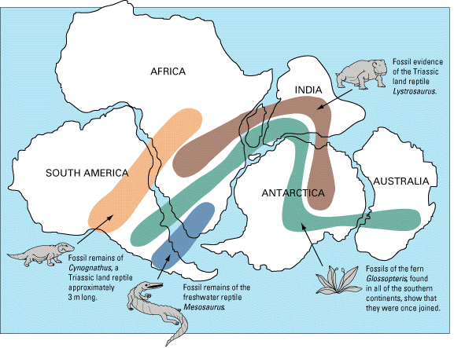
Continental separation
Requires massive forces to split the continents
Massive forces to overcome inertia and start movement
Massive forces to stop movement
Needs an external force
Notes:
If the rock was indeed washed into the Mozambique Channel we have another problem -- where did the Mozambique Channel come from?
And the Mariana Trench?
Huge holes into which huge volumes of material have seeming disappeared?
And where did the water come from and where did it go?

Slide 24
Continental separation
Imagine rapid separation of continents
What if simultaneously the earth expanded as a consequence of all the surface disruption breaking the crust which would have contracted rapidly as a consequence of rapid cooling?
What if several kilometers depth of water drained off the land in a very short space of time – perhaps days or weeks?
What if the water flow had the erosive capacity to cause the topography that I have described and the topography in the part of the world where you live?
What if ... ?
Notes:
If the rock was indeed washed into the Mozambique Channel we have another problem -- where did the Mozambique Channel come from?
And the Mariana Trench?
Huge holes into which huge volumes of material have seeming disappeared?
And where did the water come from and where did it go?

Slide 25
Continental separation
Some theories
Thermal convection of the earth’s core slowly over millions of years
Impact by a large object from space
Fly-by of a large space object – a near miss
Contraction of the crust causes cracking
Other?
Or a combination – fly by and impact results in disruption and cooling which results in cracking followed by a change in gravitational state which results in major expansion due to reduced gravitational force?
Notes:
If the rock was indeed washed into the Mozambique Channel we have another problem -- where did the Mozambique Channel come from?
And the Mariana Trench?
Huge holes into which huge volumes of material have seeming disappeared?
And where did the water come from and where did it go?

Slide 26
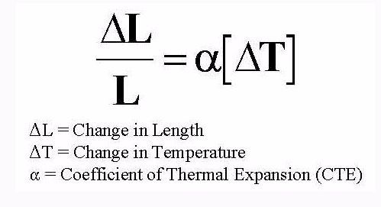

Continental separation
Hypothesis for splitting / cracking
Coefficient of thermal expansion:
Granite 6.5 micrometers per meter at 20 degrees Centigrade
Melting point of Granite = 1,700 degrees Centigrade
Cooling from molten to zero degrees would shrink the
circumference of the earth by approximately 427 km
BUT the core would NOT shrink
Massive tension and splitting of the crust would result
Notes:
If the rock was indeed washed into the Mozambique Channel we have another problem -- where did the Mozambique Channel come from?
And the Mariana Trench?
Huge holes into which huge volumes of material have seeming disappeared?
And where did the water come from and where did it go?

Slide 27
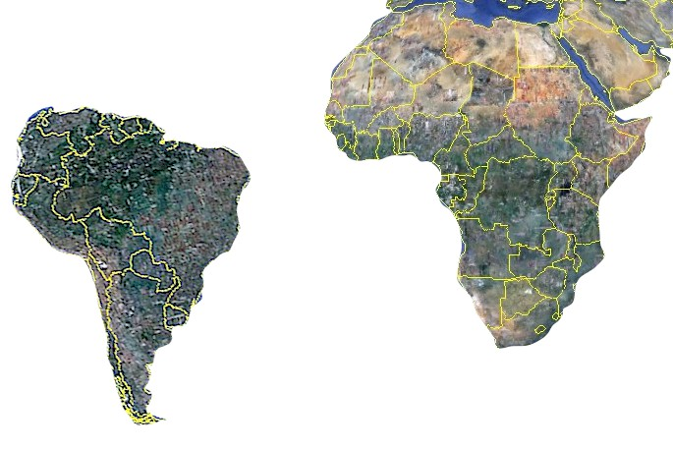
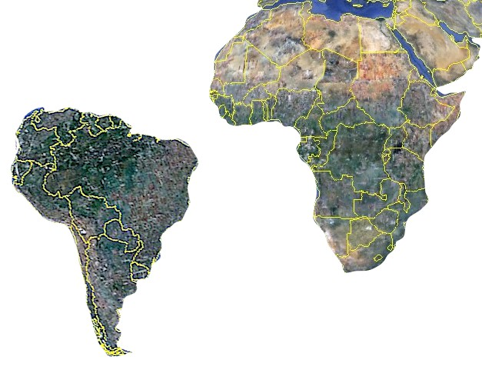
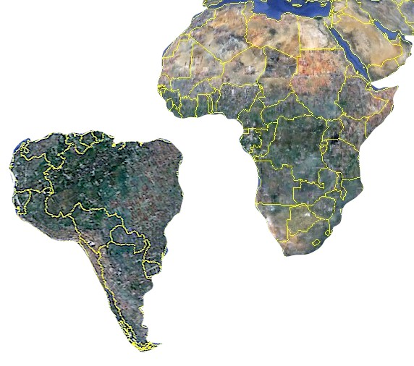
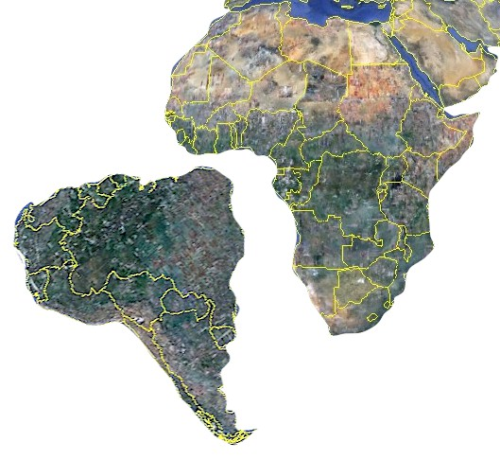
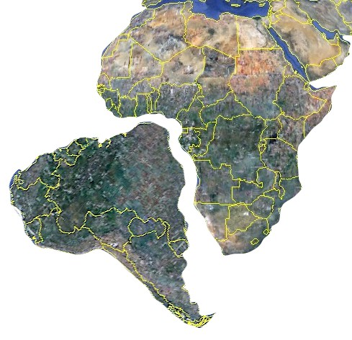
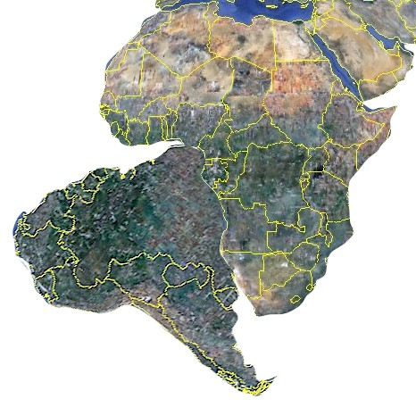
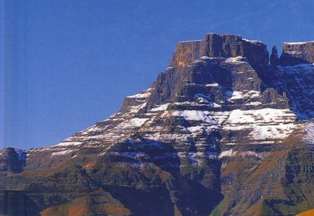
Continental separation and water drainage
As continents separate massive gorges form
Water rushes off
the continents
Massive erosion beyond anything we can visualize occurs
Notes:
If the rock was indeed washed into the Mozambique Channel we have another problem -- where did the Mozambique Channel come from?
And the Mariana Trench?
Huge holes into which huge volumes of material have seeming disappeared?
And where did the water come from and where did it go?

Slide 28
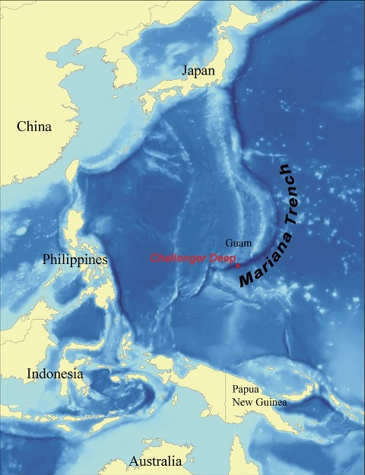
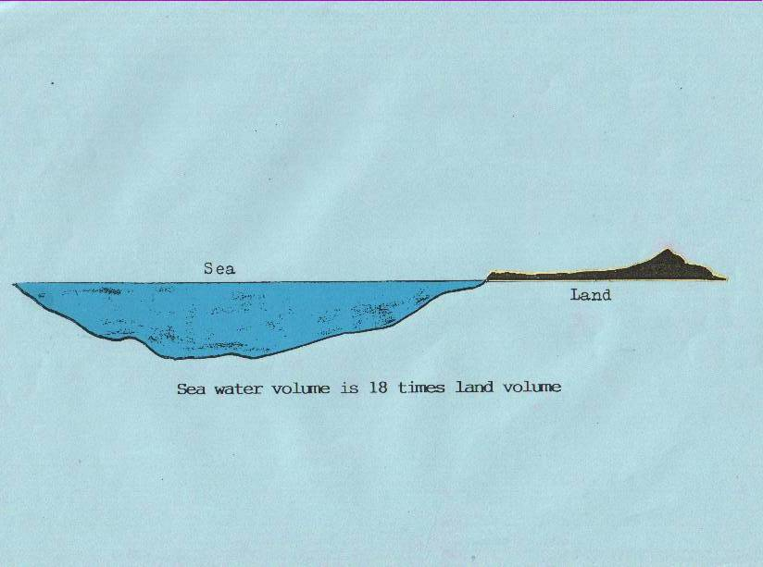
Ocean trenches
Another source of drainage
The Mariana Trench is 11,000 m deep
Seemingly concurrently with continental separation trenches were also formed further draining water off the continents
The volume of the seas is MUCH greater than the volume of the continents
Easy to postulate rapid and dramatic drainage
Notes:
If the rock was indeed washed into the Mozambique Channel we have another problem -- where did the Mozambique Channel come from?
And the Mariana Trench?
Huge holes into which huge volumes of material have seeming disappeared?
And where did the water come from and where did it go?

Slide 29
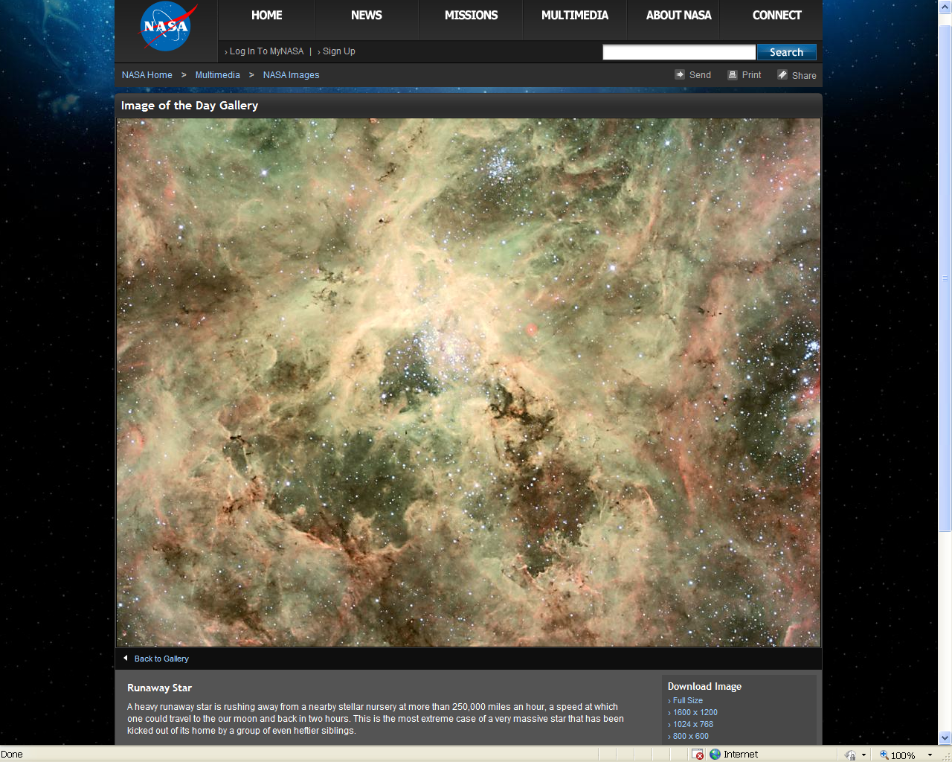
How?
Unstable Universe -- massive runaway star earth to Moon in 1 hour

Slide 30
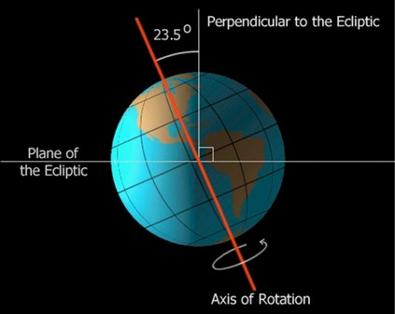
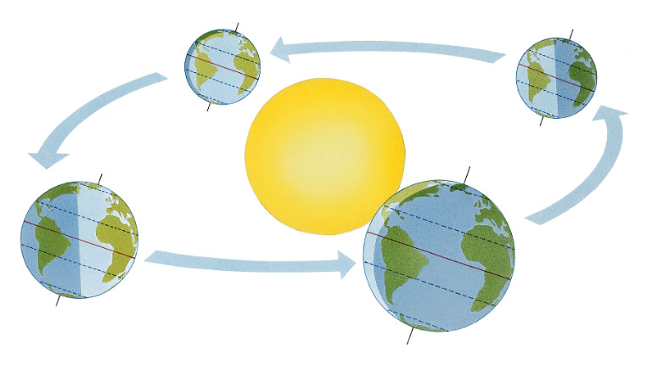
Continental separation
Hypothesis for displacement
Fly-by of large space object
Theories that earth’s axis was once
vertical
That orbit of sun was not elliptical
That a year was exactly 360 days
A large comet or other space object
that exerted massive gravitational
pull on the earth could pull the earth
out of a circular orbit around the sun
AND cause the earth to tilt on its axis, one theory says close to 30 degrees originally
WHY NOT?
Notes:
If the rock was indeed washed into the Mozambique Channel we have another problem -- where did the Mozambique Channel come from?
And the Mariana Trench?
Huge holes into which huge volumes of material have seeming disappeared?
And where did the water come from and where did it go?

Slide 31
Summing up
Large valleys incised in the dome and elsewhere – all over the earth
Too large to be formed by current streams
Massive plucking of cliff faces and tops of hills
Continents were originally one land mass
Thermal shrinkage of the crust due to cooling explains splitting up of the continents
Massive fly-by or impact of a space object tilting the earth on its axis, distorting its orbit around the sun and causing massive shear (hysteresis) between crust and core can explain separation of continents
All happened rapidly – mechanically impossible to happen slowly
How long ago?

Slide 32
Turning history on its head
Massive evidence of a global flood
What does it all mean?
Continued in part 7
The REAL Age of all this
Contact me James@ETI-Ministries.org Website www.ETI-Ministries.org

